Slide 1

Unit-06 Inheritance and Abstraction
Object Oriented Programming (OOP)
(21CS01203)
Prof. Arjun V. Bala
Computer Engineering Department
arjun.bala@darshan.ac.in
9624822202

Slide 2

Outline
Inheritance
Types of inheritance
Overriding
Super keyword
Final keyword
Finalize method
Dynamic Method Dispatch
Abstract class
Interface
Looping

Slide 3
Inheritance
The mechanism of deriving a new class from an old class is called inheritance or derivation.
The old class is known as base class while new class is known as derived class or subclass.
It lets programmers create new classes that share some of the attributes of existing classes.
Inheritance lets us build on previous work without reinventing the wheel.
The inheritance is the most powerful feature of OOP.
Through effective use of inheritance, we can save lot of time in programming and also reduce errors, which in turn will increase the quality of work and productivity.
Employee
Manager
Worker
- ID
- Name
- Address
- Contact
- ID
- Name
- Address
- Contact
- MonthlySalary
- ID
- Name
- Address
- Contact
- DailySalary
- NoOfHours

Slide 4
Inheritance using extends keyword
When a Class extends another class it inherits all non-private members including fields and methods.
Inheritance in Java can be best understood in terms of Parent and Child relationship, also known as Super class(Parent) and Sub class(Child).
Inheritance defines IS-A relationship between a Super class and its Sub class.
For Example :
Car IS A Vehicle
Bike IS A Vehicle
EngineeringCollege IS A College
MedicalCollege IS A College
MCACollege IS A College
extends is the keyword used to implement inheritance.

Slide 5
extends (Cont.)
Syntax :
Vehicle
noOfPassanger
maxSpeed
noOfWheels
noOfGears
noOfPassanger
maxSpeed
noOfWheels
noOfGears
noOfPassanger
maxSpeed
noOfWheels
noOfGears
noOfPassanger
maxSpeed
noOfWheels
noOfGears
class A {
// code
}
class B extends A{
// code
}
extends
extends
extends
Example:
Bike
cubicCapacity
isMoped
Bike
cubicCapacity
isMoped
Car
horsePower
noOfAirBags
tollTaxAmount()
Car
horsePower
noOfAirBags
tollTaxAmount()
Truck
horsePower
loadingCapacity
payTollTax()
Truck
horsePower
loadingCapacity
payTollTax()
class Vehicle {
. . . . . .
}
class Bike extends Vehicle{
. . . . . .
}
class Car extends Vehicle{
. . . . . .
}

Slide 6
Example (Inheritance)
class Vehicle {
int noOfPassanger;
int maxSpeed;
public void display() {
System.out.println("Passangers = " + noOfPassanger);
System.out.println("Max Speed = " + maxSpeed);
}
}
class Car extends Vehicle {
double horsePower;
int noOfAirbags;
public void display() {
System.out.println("Passangers = " + noOfPassanger);
System.out.println("Max Speed = " + maxSpeed);
System.out.println("Hourse Power = " + horsePower);
System.out.println("Airbags = " + noOfAirbags);
}
}

Slide 7
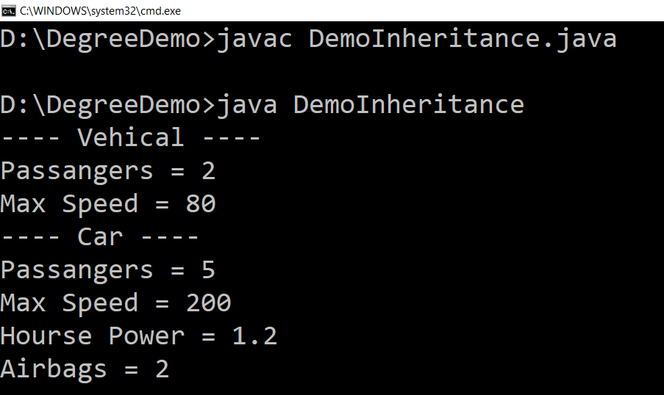
Example (Inheritance) (Cont.)
public class DemoInheritance {
public static void main(String ar[]) {
Vehicle v = new Vehicle();
v.maxSpeed = 80;
v.noOfPassanger = 2;
System.out.println("---- Vehicle ----");
v.display();
Car c = new Car();
c.maxSpeed = 200;
c.noOfPassanger = 5;
c.horsePower = 1.2;
c.noOfAirbags = 2;
System.out.println("---- Car ----");
c.display();
}
}

Slide 8
Types of Inheritance in Java
1. Single Inheritance
2. Hierarchical Inheritance
3. Multilevel Inheritance
A
A
A
B
B
C
B
C
4. Multiple Inheritance
5. Hybrid Inheritance
A
B
A
Note: Multiple and Hybrid Inheritance is not supported in Java with the Class Inheritance, we can still use those Inheritance with Interface which we will learn in later part of the Unit
C
B
C
D

Slide 9
Inheritance (Cont.)
Each Java class has one (and only one) superclass.
C++ allows multiple inheritance
BUT
Java does not support multiple inheritance
There is no limit to the number of subclasses a class can have
Inheritance creates a class hierarchy
Classes higher in the hierarchy are more
general and more abstract
Classes lower in the hierarchy are more
specific and concrete
There is no limit to the depth of the class tree.
Class
Class
Class
Class
Class
Class
Class
Class
Class
Class
Class

Slide 10
Object class
Object class is super class of all the classes.
The Object class is defined in the java.lang package
Object
….
….
….
….
….
….
….
….
….
….
….
….
….

Slide 11
Constructors in Inheritance
Classes use constructors to initialize instance variables
When a subclass object is created, its constructor is called after the superclass default constructor.
It is the responsibility of the subclass constructor to invoke the appropriate superclass constructors so that the instance variables defined in the superclass are properly initialized
Superclass constructors can be called using the "super" keyword in a manner similar to "this"
It must be the first line of code in the constructor
If a call to super is not made, the system will automatically invoke the no-argument constructor of the superclass.

Slide 12
For midsemester exam we have only this much topics

